Slide 1

SRM INSTITUTE OF SCIENCE AND TECHNOLOGY FACULTY OF ENGINEERING AND TECHNOLOGY
DEPARTMENT OF COMPUTER SCIENCE AND ENGINEERING 15CS496L MAJOR PROJECT
<STUDENT REPORT MANAGEMENT SYSTEM>
Nikhil Kumar Reg No: RA2211031010097
Priyanshu Dalakoti Reg No: RA2211031010107
Shashwat Agarwal Reg No: RA2211031010083
Batch ID:
Guide name and Designation: Dr. Manickam.M,
Assistant Professor, CSE department

Slide 2
Table of contents
Abstract
Introduction
Literature Survey
Objective of the Project
Architecture
Modules Description
Conclusion

Slide 3
ABSTRACT
In the dynamic landscape of educational institutions, the effective management of student reviews and feedback is pivotal in enhancing the quality of education and facilitating continuous improvement. This mini project introduces the "Student Review Management System," a comprehensive digital solution designed to streamline and optimize the process of collecting, analyzing, and utilizing student feedback.

Slide 4
INTRODUCTION
The traditional methods of collecting and managing student reviews often involve paperwork, manual data entry, and cumbersome administrative processes. These limitations have inspired the development of our Student Review Management System, aimed at revolutionizing the way educational institutions handle student feedback.

Slide 5
LITRATURE SURVEY
S.No | NAME | Year | METHOD USED | MERITS | DEMERITS
1 | Fredrick Mtenzi |  |  |  | Limited scalability for larger institutions. Lacked advanced security measures.
2
3

Slide 6
OBJECTIVE
The primary objective of this mini project is to create a user-friendly and efficient platform that benefits both students and educators:
Efficient Data Collection: Implement an intuitive interface for students to submit feedback conveniently, reducing the barriers to participation.
Real-time Data Analysis: Utilize data analytics techniques to process and analyze feedback promptly, enabling institutions to identify trends and areas for improvement swiftly.
Streamlined Communication: Establish a seamless communication channel between students and faculty, allowing instructors to respond to feedback and address concerns promptly.
Quality Enhancement: Facilitate data-driven decision-making processes to enhance the quality of education and overall institutional performance.

Slide 7
ARCHITECTURE
The Student Review Management System architecture is designed with modularity and scalability in mind. It comprises four key components:
User Interface: A user-friendly web-based interface for students to submit reviews and faculty to access feedback.
Database: A robust and secure database system to store and manage feedback data efficiently.
Data Analytics Engine: Utilizes data mining and machine learning techniques to analyze feedback data and extract valuable insights.
Communication Module: Enables real-time communication between students and faculty members.

Slide 8
MODULE DESCRIPTION
User Registration and Authentication: Allows students and faculty to create accounts and securely access the system.
Feedback Submission: Provides students with a platform to submit detailed feedback on courses, instructors, and other aspects of their educational experience.
Data Processing: Utilizes algorithms for sentiment analysis, trend identification, and data summarization to process feedback data.
Communication: Facilitates direct communication between students and faculty for query resolution and discussion.
Reporting: Generates comprehensive reports and visualizations to present feedback trends and insights.
Administrator Dashboard: Provides administrators with control over user management, system settings, and data access.

Slide 9
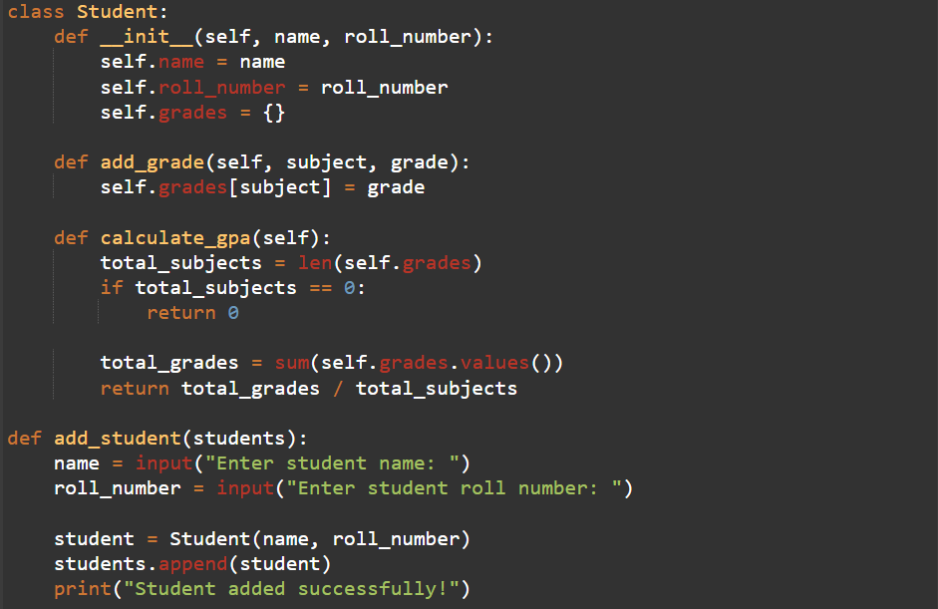
Screenshots of project

Slide 10
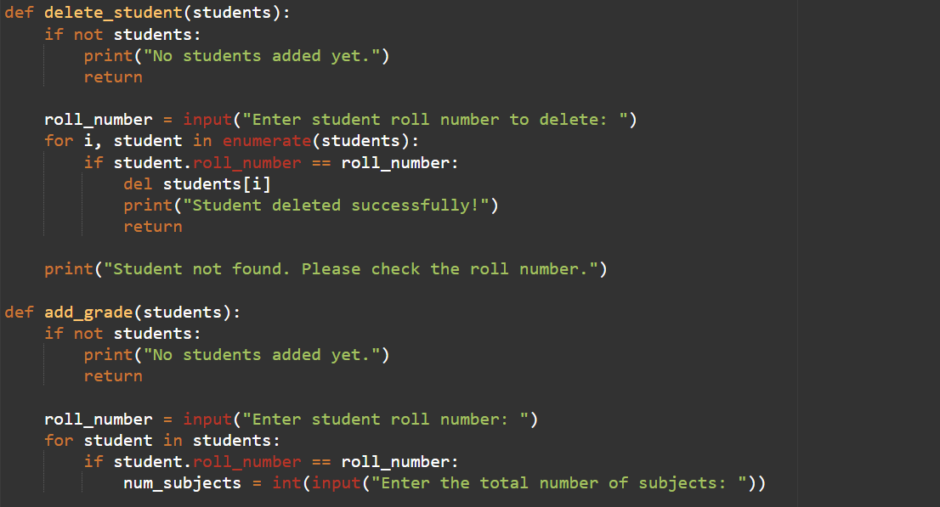

Slide 11
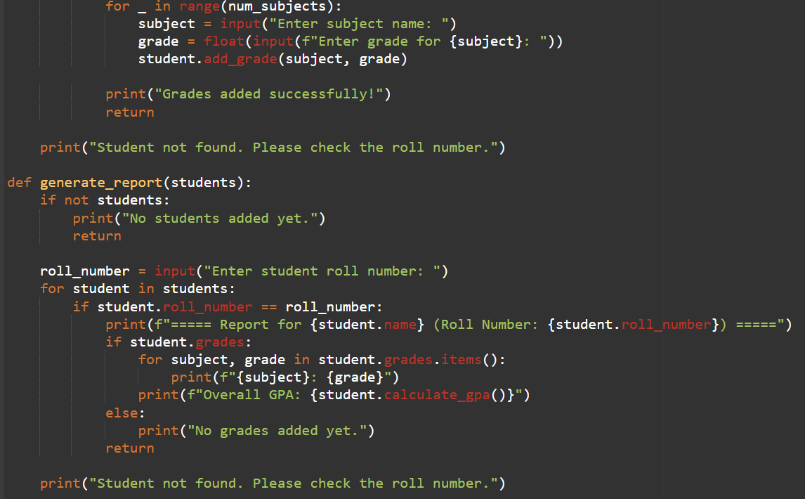

Slide 12
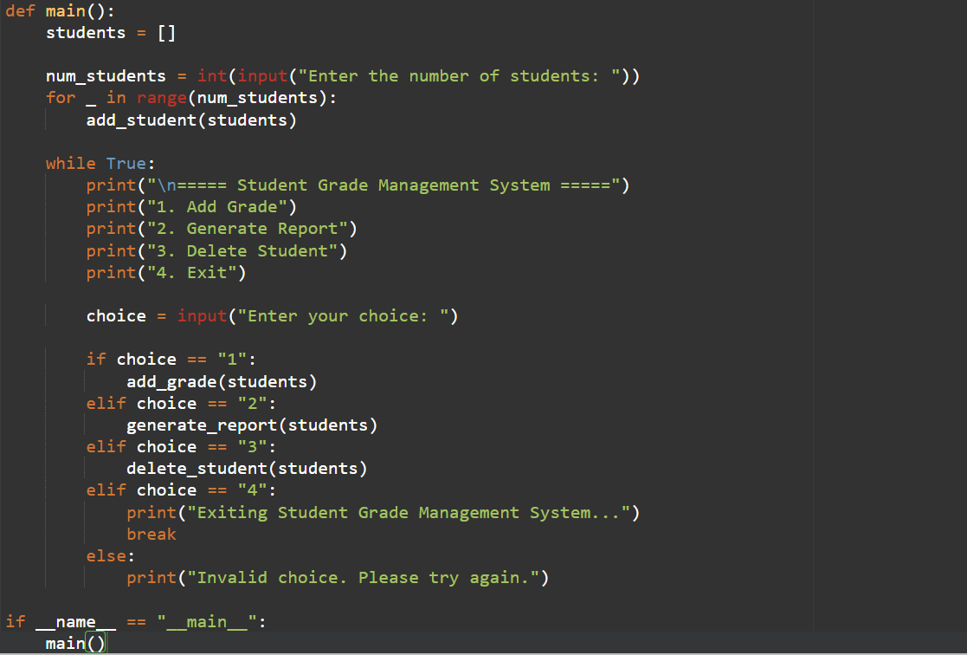

Slide 13
CONCLUSION
The Student Review Management System mini project addresses the critical need for a more efficient and data-driven approach to student feedback management. By streamlining the feedback collection process, offering real-time analysis, and promoting effective communication, our system aims to contribute to the overall enhancement of educational quality and institutional performance.
This project showcases the potential of technology in transforming traditional educational processes and lays the foundation for more sophisticated and data-driven feedback management systems in the future.

Slide 14
References
https://www.geeksforgeeks.org
https://www.wikipedia.org
https://www.python.org
https://www.ieee.org
https://www.mysql.com

Slide 15
Thank You

